Slide 1
HealthSpotter
BDA Group 9

Slide 2
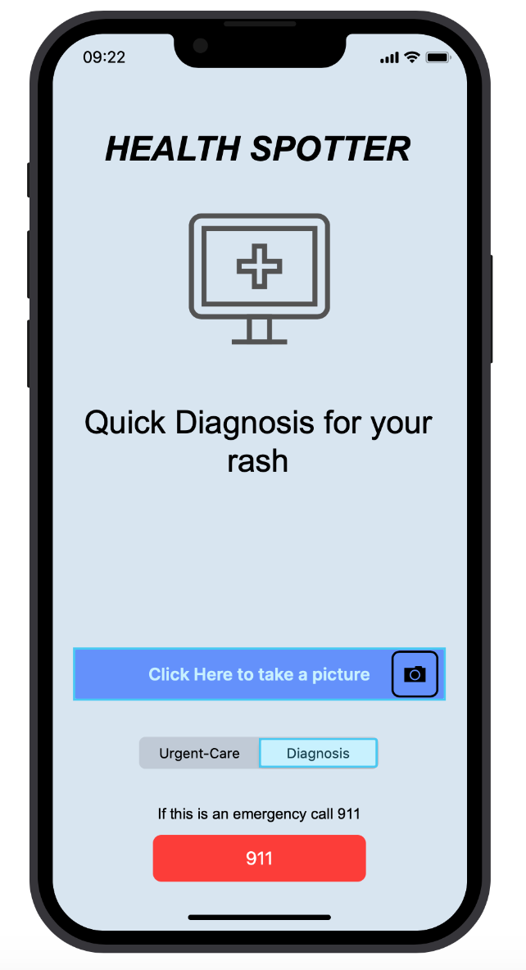
What is HealthSpotter?
HealthSpotter is a mobile App
AI Image recognition for skin preliminary diagnosis
Physician recommendation for further treatment
Clinic recommendation based on various elements:
Clinic ratings
Insurance provider
Wait time
Notes:
HealthSpotter is an app that will allow a user to take a photograph of a rash/pimple/bug bite and be able to identify it within a shown likelihood, then recommend a clinic or healthcare professional to further diagnose and treat their condition.
This will be paired with a an application that will provide recommendations of clinics for patients based off a number of parameters (e.g.wait time, clinic rating, insurance provider)

Slide 3

What problem are we solving
Have you ever…
Had trouble finding a health center that takes your insurance?
Waited for over an hour to get medical care?
Had trouble describing your symptoms to your doctor?
HealthSpotter can give you the power to:
Find the nearest health centers, filtered by insurance providers.
Check wait times for all nearby locations.
Simple symptom descriptions to provide information for your doctor.
Snap a photo to give likely diagnosis of your ailment.

Slide 4

Demo Video

Slide 5

Questions?
Comments?
Concerns?
Applause?

